Slide 1
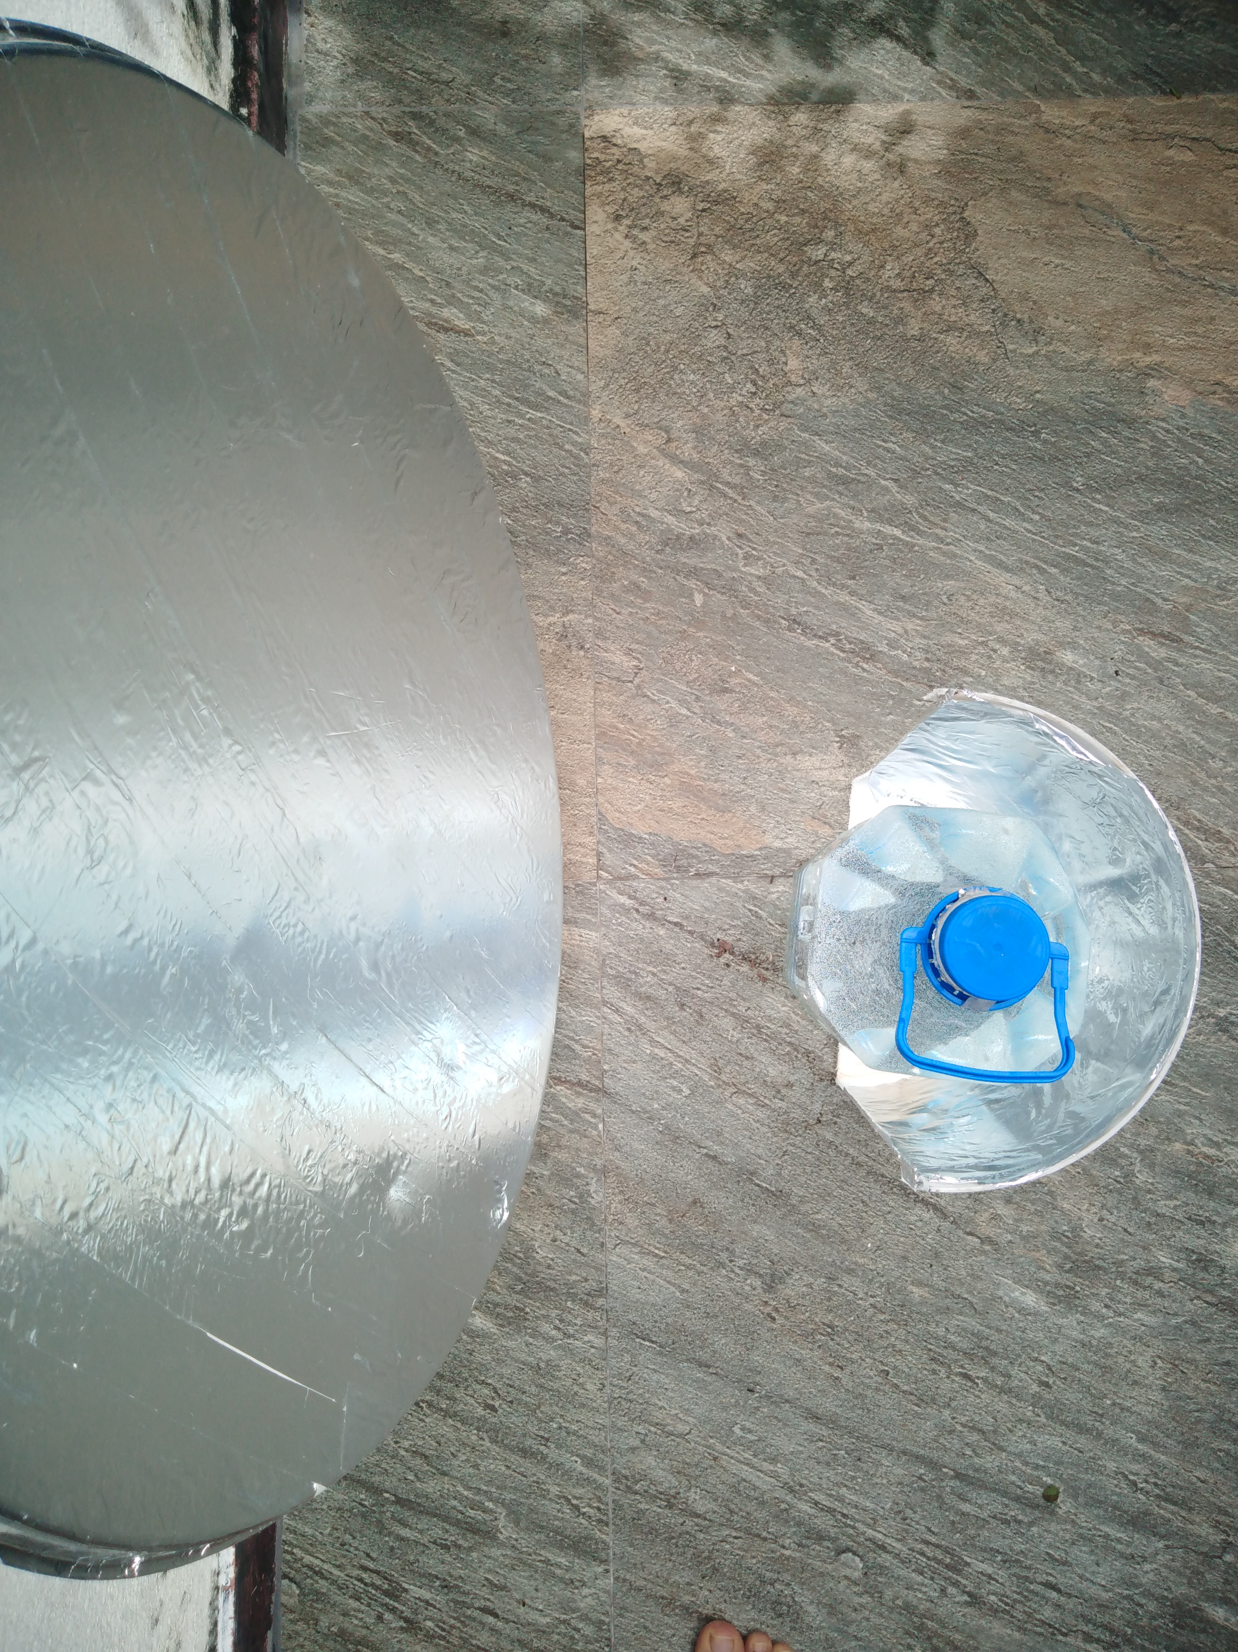
CSP Water Heater
Gamika Seneviratne

Slide 2
Abstract
Aim: Introduce the concept of a cheap, DIY design for a solar water heater
Application: For rural areas, low-capita income, with cold whether
Requirements: Reused satellite dish, foil/wrapping paper, bottle, PVC/metal pipe

Slide 3
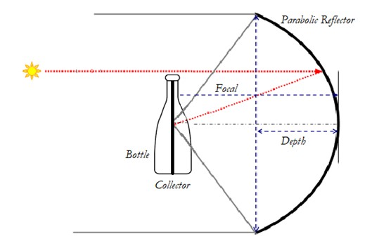
Principle
Parabolic dish acts as concentrator
Bottle is heated from the inside – 100% of energy directly transferred to surrounding water from receiver
Heat losses only from water to surface of bottle, limited by covering bottle with wrapping paper
Source: Rebuilt from various sources

Slide 4
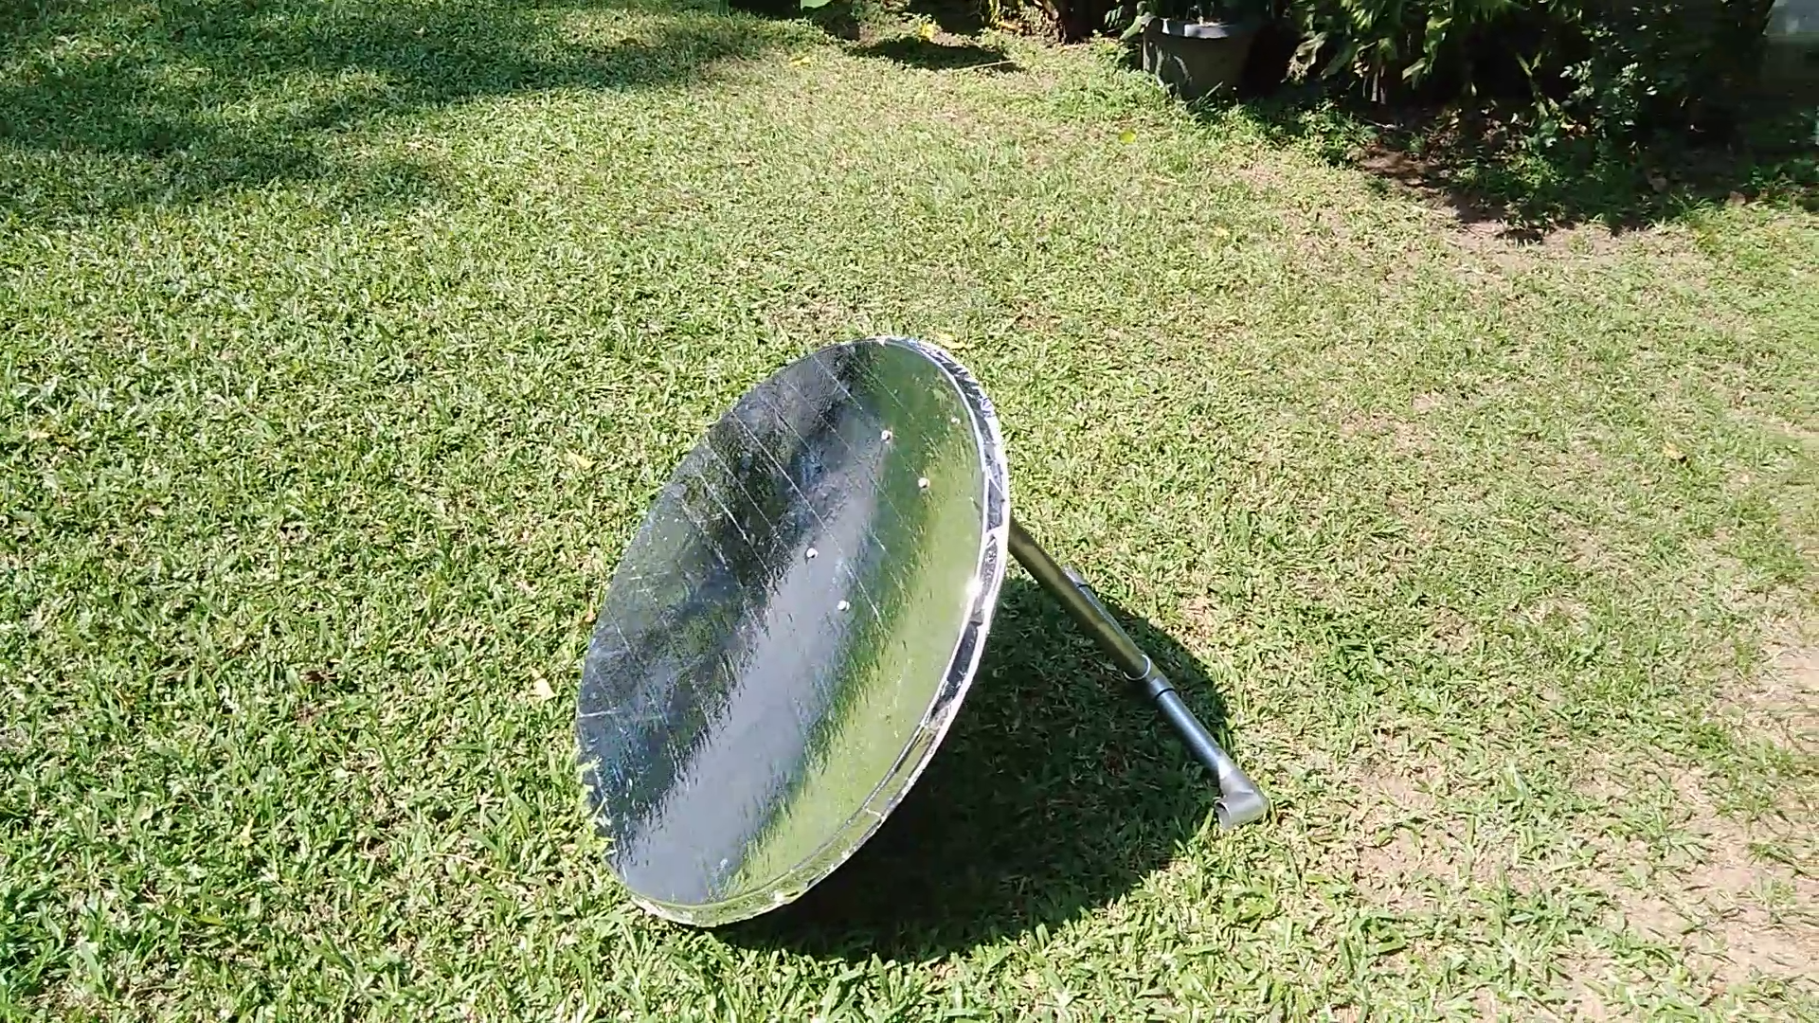
Design
CSP is an established technology so why is this different? Our set-up recycles/uses cheap products
Concentrator - Recycled satellite TV dish which acts as an efficient parabolic concentrator
Water storage - Fully transparent plastic or glass bottle
Receiver - PVC pipe, best coated with non-reflective paint
Video: https://www.youtube.com/watch?v=eoZ5gvtdADc

Slide 5
Testing and Results
This CSP setup was capable of heating a 5L bottle (PET plastic) to 70C in (ambient 25C ) in ~2 hours
Or ~0.4KWh of energy saved
Results achieved under constant sunshine with no cloud cover (over ‘winter’; Nov – Jan)
System is much cheaper than current Solar Thermals and far more efficient at heating applications vs. direct electricity from PVs
Quite durable if used with care (4 months with minimal deterioration). The aluminum foil/wrapping paper comes with some inherent protection and has reduced heat wear due to its high reflectivity
Practical concerns:
Device requires sun-tracking adjustments every ~45mins to align the focal point to receiver
Dish must be cleaned occasionally
Care must be taken to avoid aligning focal point in direction of person or flammable objects (e.g. youtube.com) . Sunglasses are highly recommended

Slide 6
Other Design Considerations
Other configurations include;
Linear Fresnel Reflectors (LFR)
Parabolic Trough Collectors (PTC)/ Compound Parabolic Concentrators (CPCs)
For e.g. tracking is often a problem with CSP devices, therefore a CPC configuration would largely mitigate this
Do not require actuation to track the sun – high acceptance angles
(a) Parabolic trough collector (b) a compound parabolic collector
Source: Solar photocatalysis for water disinfection

Slide 7
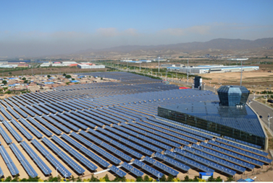
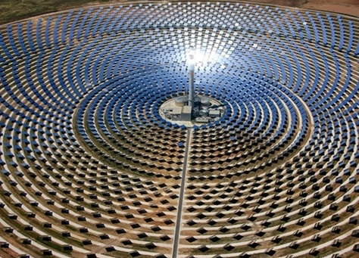
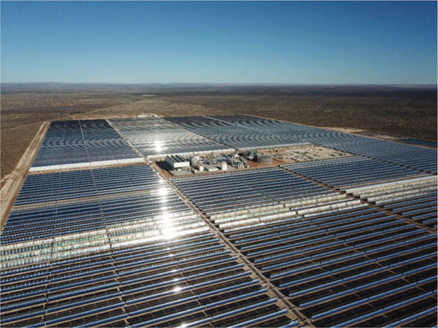
Industrial Uses
Industrial scale heating applications e.g. supportive heating fo (e.g. food processing, sterilizing, drying, preheating of boiler feed, etc)
Water disinfection and even desalination
High power application can be used to drive steam turbines for electricity generation
Fig: Baotou, Mongolia, heating to shopping centers
Fig: Morocco’s 160MW Noor I plant
Fig: 100MW Kathu CSP in South Africa
Source: https://www.solarthermalworld.org
Source: http://www.horizon-ste.eu/about-ste/
Source: https://www.ee.co.za/article/kathu-plant

Slide 8
Aim
Find interested partners willing to explore the merits and feasibility of both small and large scale CSP application locally
My contact details
Email: gamikaseneviratneaud@gmail.com
Mobile: +94778867684
Thank you!

